Slide 1



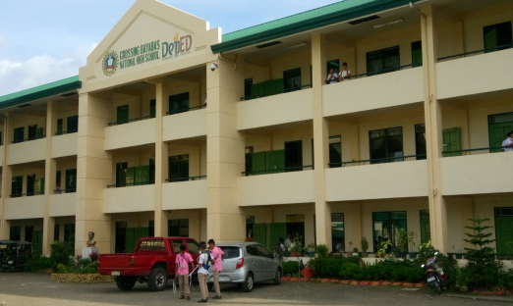
HiSRMS Manual
General User Guide for Dummies

Slide 2
Table of Contents

Slide 3

HiSRMS Launcher
01
Opens and manages the modules used by the entire system. It also manages the variables used for processing the records inside the system.

Slide 4
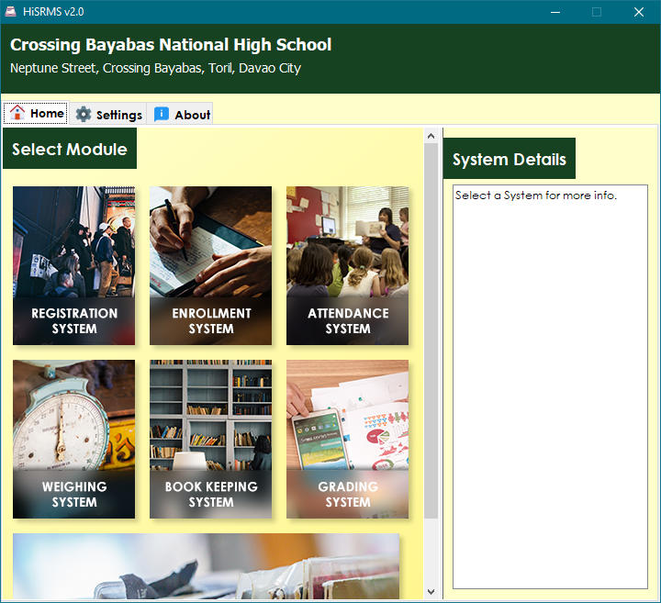
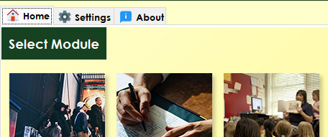
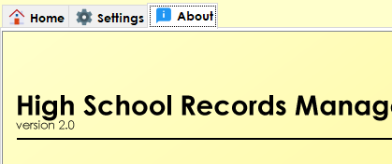

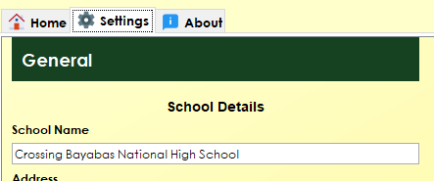
The General User Interface
1. Home Tab
3. About Tab
Contains all the applications installed on the system ( 7 in total ).
Shows detailed information about the software.
2. Settings Tab
Note
Contains modifiable variables that will be used by the other applications when processing data.

Slide 5

Registration System
02

Slide 6


Note
Caution
Yeey
Yeey
Warning
Yeey

